Slide 1
Drone Project
Zepetto
https://github.com/IeRae/Infinity-Drone-Project.git

Slide 2
Infinity Drone
– Zepetto team
CONTENTS
01.
What is Infinity Drone?
02.
How is it Organized?
03.
Who make it?
04.
About the roadmap
05.
Why Drone?
06.
Q & A

Slide 3
Infinity Drone
– Zepetto team
What is Infinity Drone?
01

Slide 4
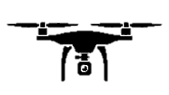

Infinity Drone
Main Subject
Controlling the Hardware
Using Server-Client
To control the drone and controller, Using Server-Client System.
To control the hardware, Using open hardware PCB(Arduino and raspberry Pi 3)

Slide 5
Infinity Drone
– Zepetto team
How is it Organized?
02
1. Hardware information
2. Software information

Slide 6
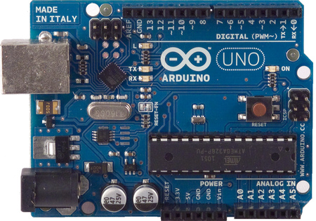
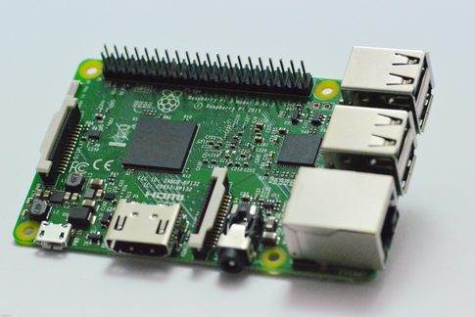
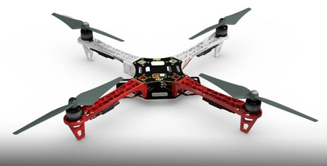
Infinity Drone
Hardware Information
Arduino UNO
Raspberry PI 3
Quadcopter
Microcontroller-based kits for building digital devices and interactive objects
In out project :
Connected with gyro sensor and motors.
Controlled Drone’s balance(PID).
The Raspberry Pi3 is a credit card-sized single-boar computer.
It’s capable of doing everything you’d expect a desktop computer to do
In out project :
Installed Server-Client program,
Connected with User.
Quadcopter is a multirotor helicopter that is lifted and propelled by four rotors.
In out project:
Frame-q450,
motor-MT2216 810kv
ESC-30A esc

Slide 7
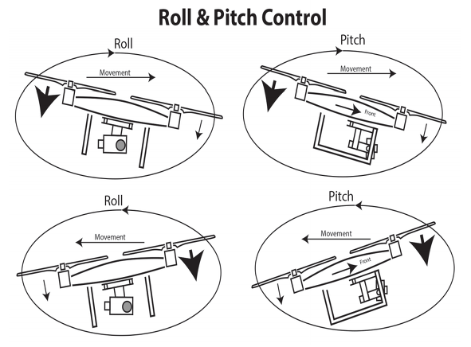
Infinity Drone
Software Information
PID
Most important part of Drone
It can make it available to be auto-balanced
Taking gyro value from mpu-6050 gyro sensor and calculate to power of motor
It’s working on Arduino board
->Arduino board only controlled Drone’s flying from Raspberry Pi 3

Slide 8
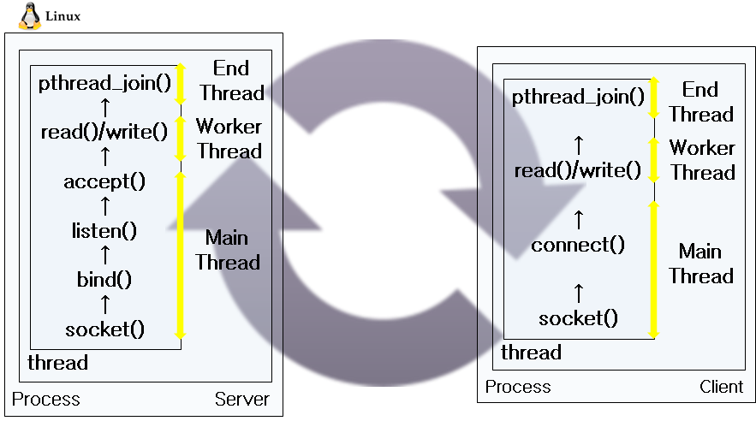
Infinity Drone
Software Information
Server-Client
Most important part of communication from drone to user, user to drone
It can be possible to control moving, flight information like video, speed, location and so on.
It’s working on Raspberry PI board as a Client
(other computer can be a server)
->Raspberry Pi board controlled Arduino, GPS, Cam,,, from User server.

Slide 9
Infinity Drone
– Zepetto team
Who make it?
03

Slide 10
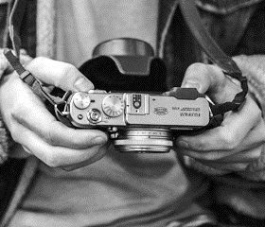


Infinity Drone
2011253063 윤이래
2011253047 이제엽
2014253002 박근령
Main part is Server design and implementation
Distribute each part and management
Main part is Client implementation
Assemble a quadcopter and management
Main part is PID programming
and Client implementation
Handing of the video tecnology

Slide 11
Infinity Drone
– Zepetto team
About Roadmap
04

Slide 12
Infinity Drone
Roadmap

Slide 13
Infinity Drone
– Zepetto team
Why Drone?
05

Slide 14
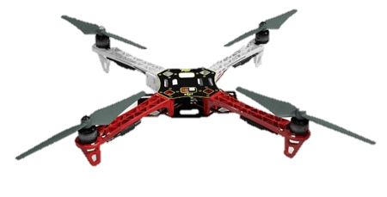
Infinity Drone
Interesting project
that deals directly with hardware
Interaction project between
human and machine
The Thread technology can be experience
by server-client programming
It is easy to incorporate
new technologies like handing img

Slide 15
Infinity Drone
– Zepetto team
Q & A
06

Slide 16
THANK YOU
Infinity Drone - Zepetto
https://github.com/IeRae/Infinity-Drone-Project.git

